Slide 1


SIMULATED FLUORESCENT LABELING
SALEH NAGHDI

Slide 2

THE INSPIRATION

Slide 3
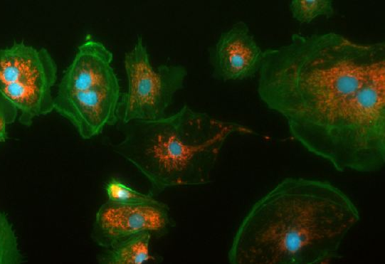
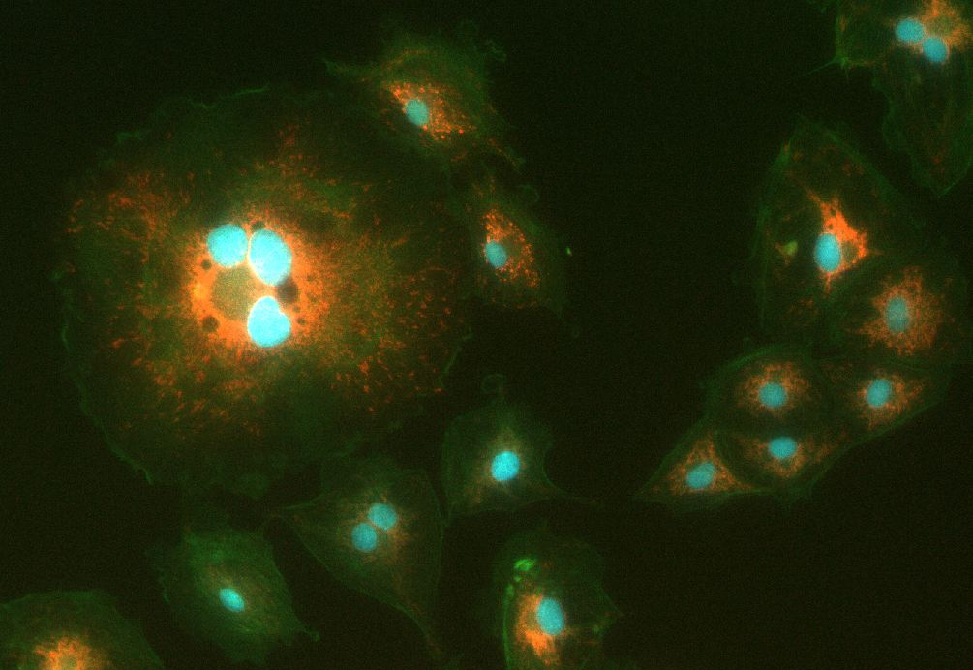
FLUORESCENT LABELING REVEALS FUNCTIONAL AND STRUCTURAL INFORMATION THAT IS TYPICALLY INVISIBLE

Slide 4
…BUT NOT WITHOUT
CHEMICAL FIXING
PHOTOTOXICITY
SPECTRAL OVERLAP
BLEACHING

Slide 5
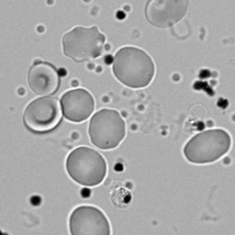
WHAT IF UNLABELED IMAGES CONTAIN LATENT STRUCTURAL INFORMATION?

Slide 6
HOW COULD WE HARNESS THIS LATENT INFORMATION?

Slide 7
THE ANSWER: A.I.
*or more specifically, General-Adversarial Networks (GANs)

Slide 8

THE JOURNEY

Slide 9
1. EARLY DAYS
concept: GIVEN ONE LABEL CHANNEL, PREDICT THE OTHER

Slide 10
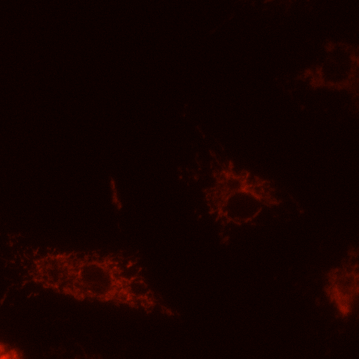
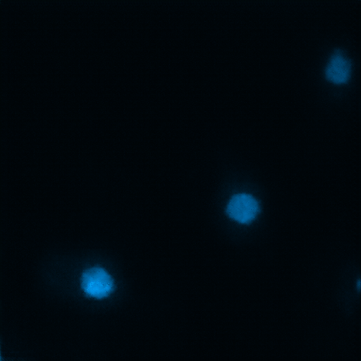
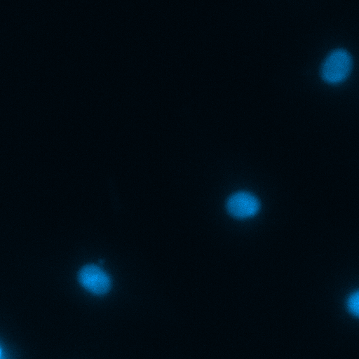

Slide 11
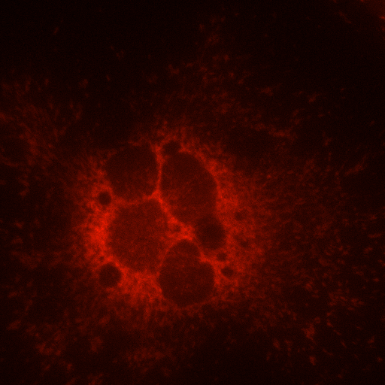
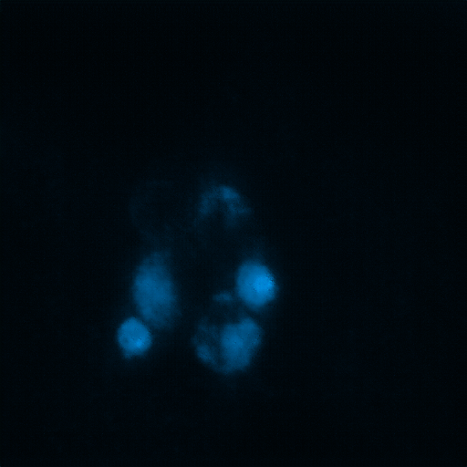
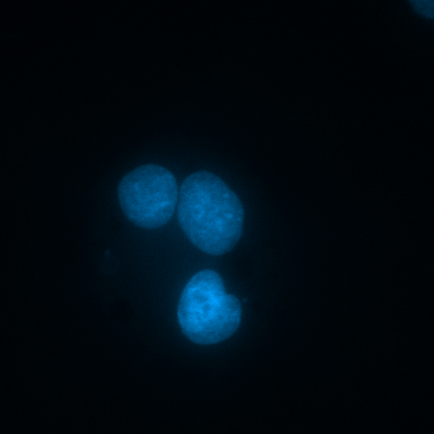
HOWEVER, PERFORMANCE WAS QUESTIONABLE AT TIMES

Slide 12
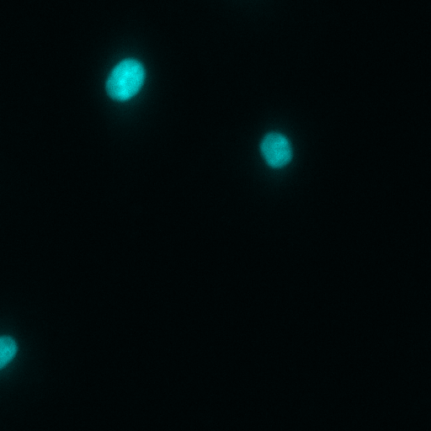
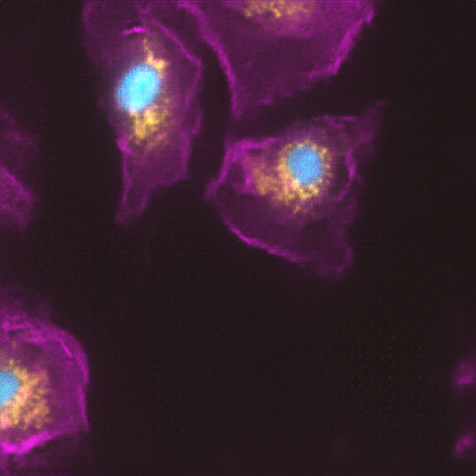
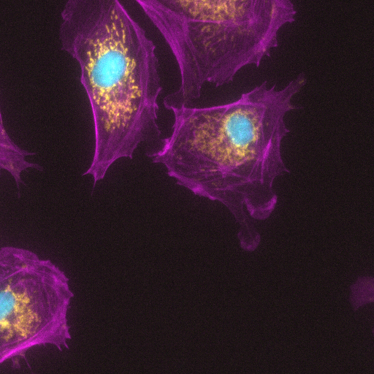
AND CONFOUNDING AT OTHERS

Slide 13
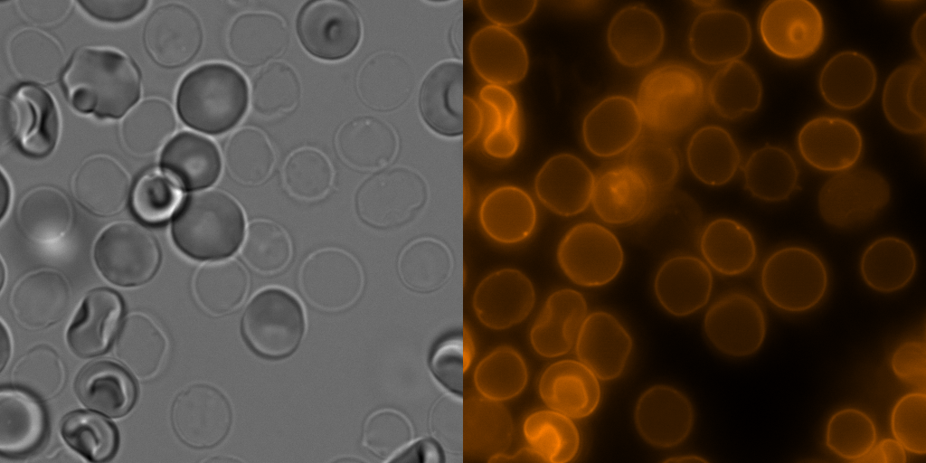
2. SIMULATING A SINGLE CHANNEL
concept:
GIVEN BRIGHTFIELD IMAGES OF RBCs, SIMULATE CELL MEMBRANE STAINING

Slide 14
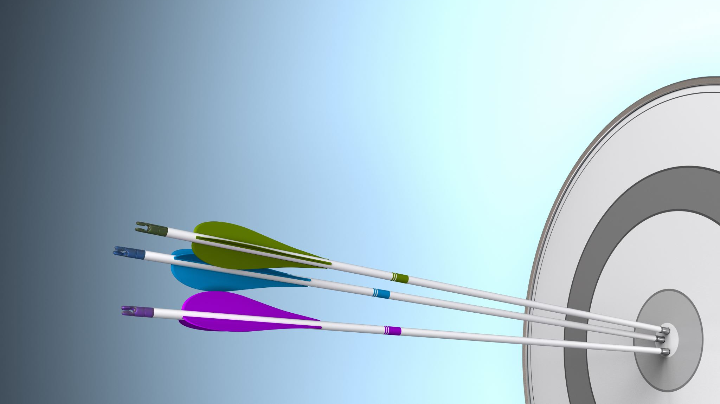
PROMISING RESULTS…

Slide 15
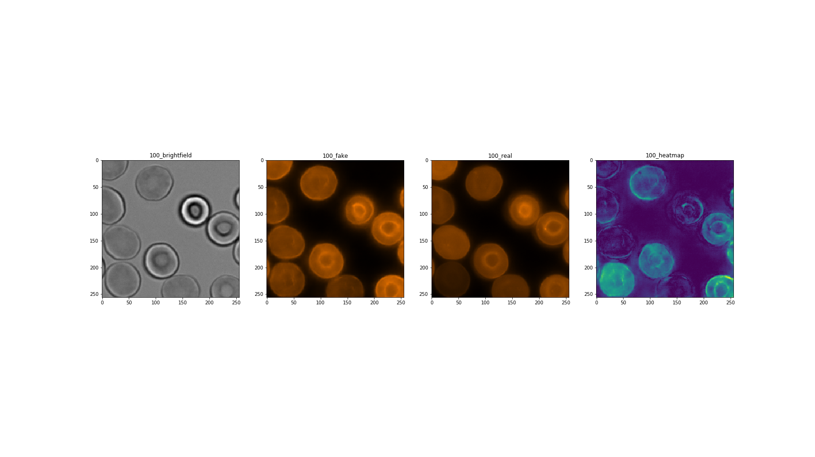

Slide 16
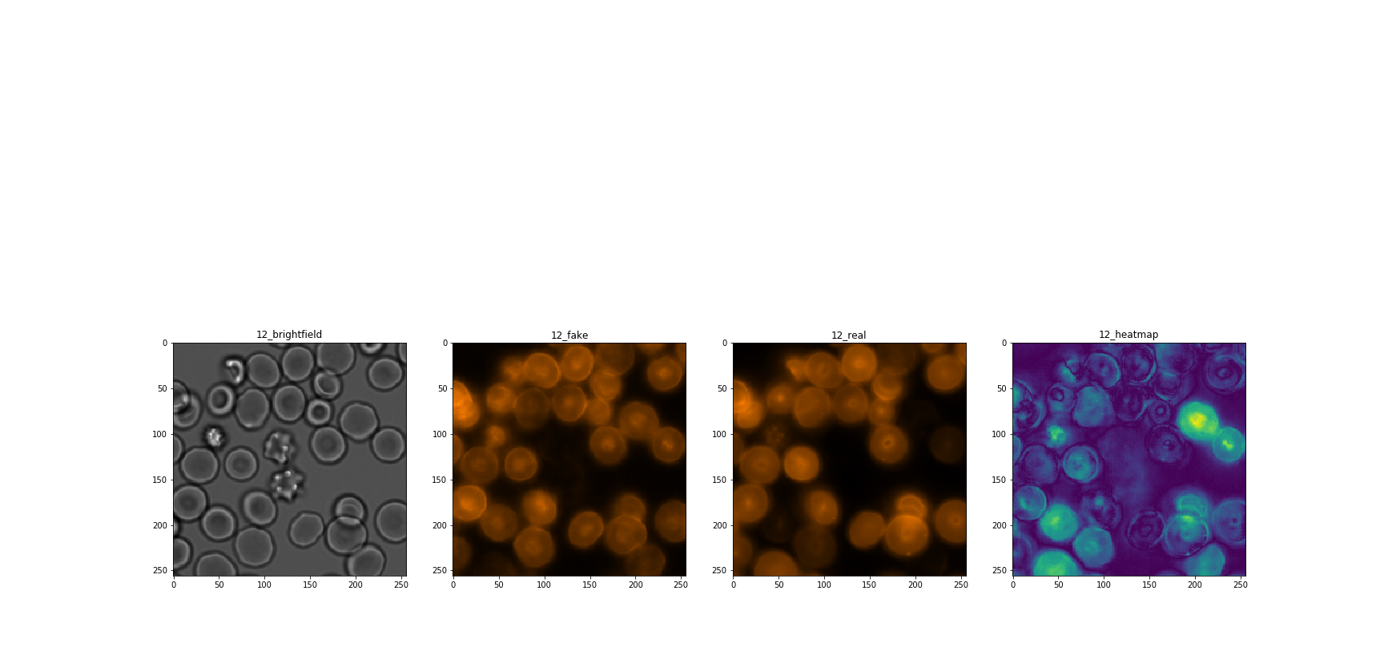
SELECTIVE LABELING
GAN learned to not label echinocytes or crenated RBCs amongst normal cells.

Slide 17
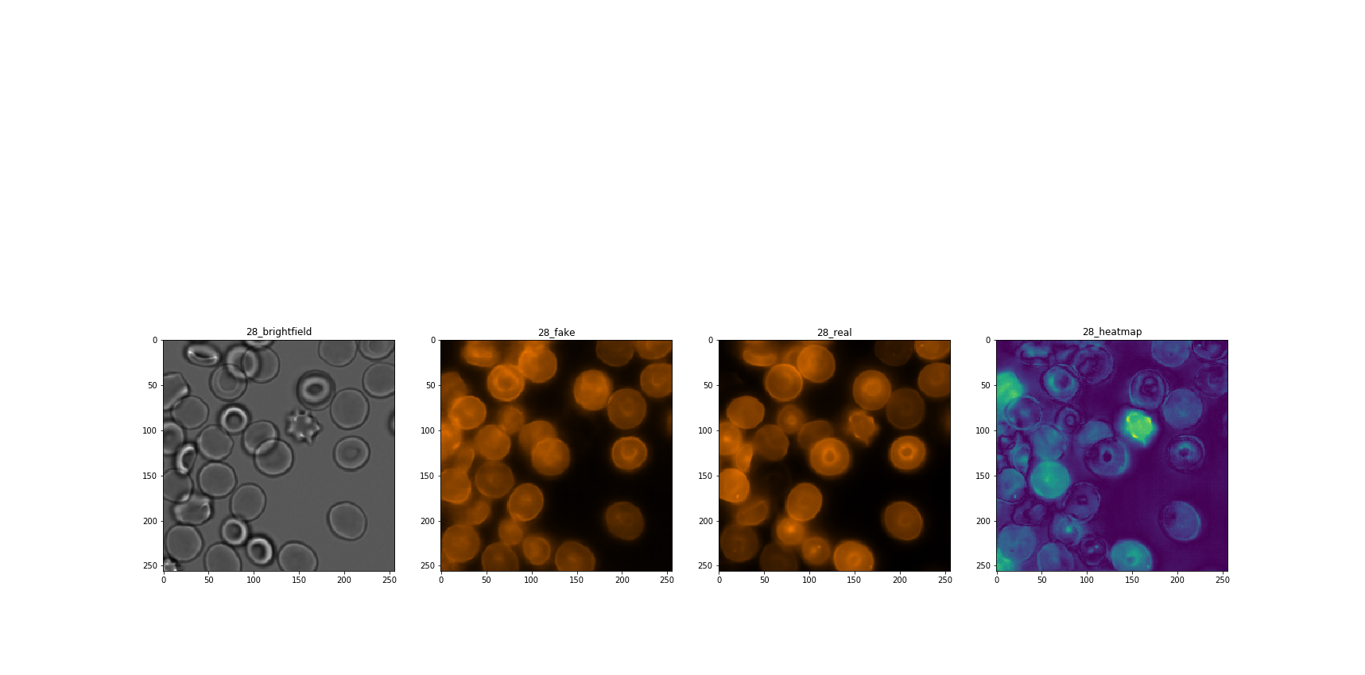
SOMETIMES EVEN BETTER THAN ACTUAL LABEL

Slide 18
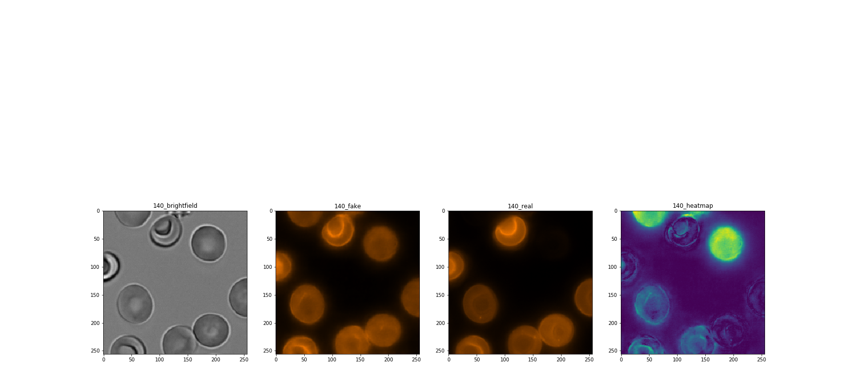
SENSITIVITY
GAN identified cells that were unregistered by real label

Slide 19
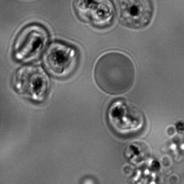
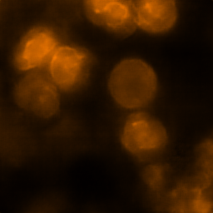
HOWEVER, DISPLAYS LIMITED ABILITY TO GENERALISE
MISCLASSIFIES TROPHOZOITE AS UNINFECTED

Slide 20
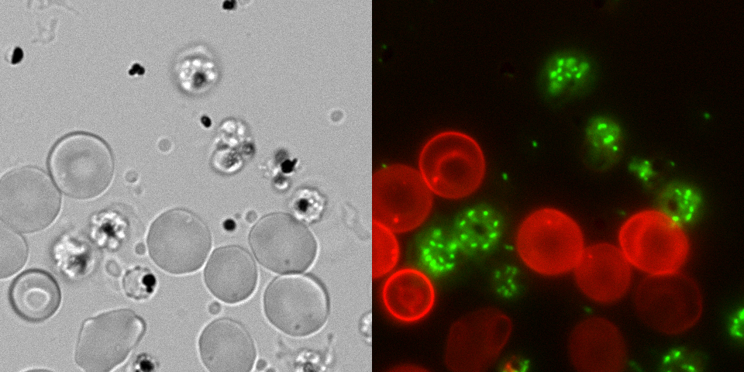
3. SIMULATING MULTIPLE CHANNELS
concept: GIVEN MALARIA-INFECTED RBC CULTURE, SIMULATE PARASITE + UNINFECTED CELL LABEL

Slide 21
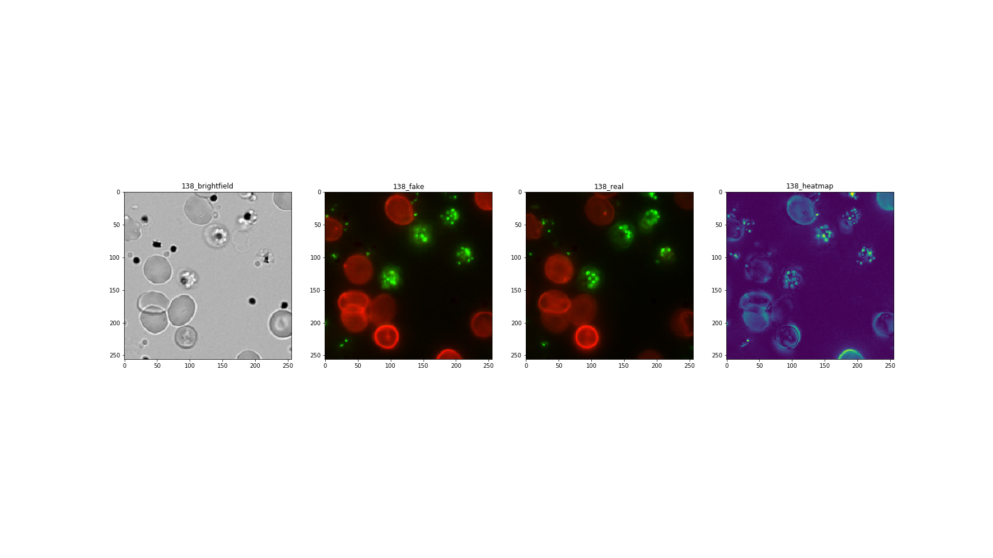

Slide 22
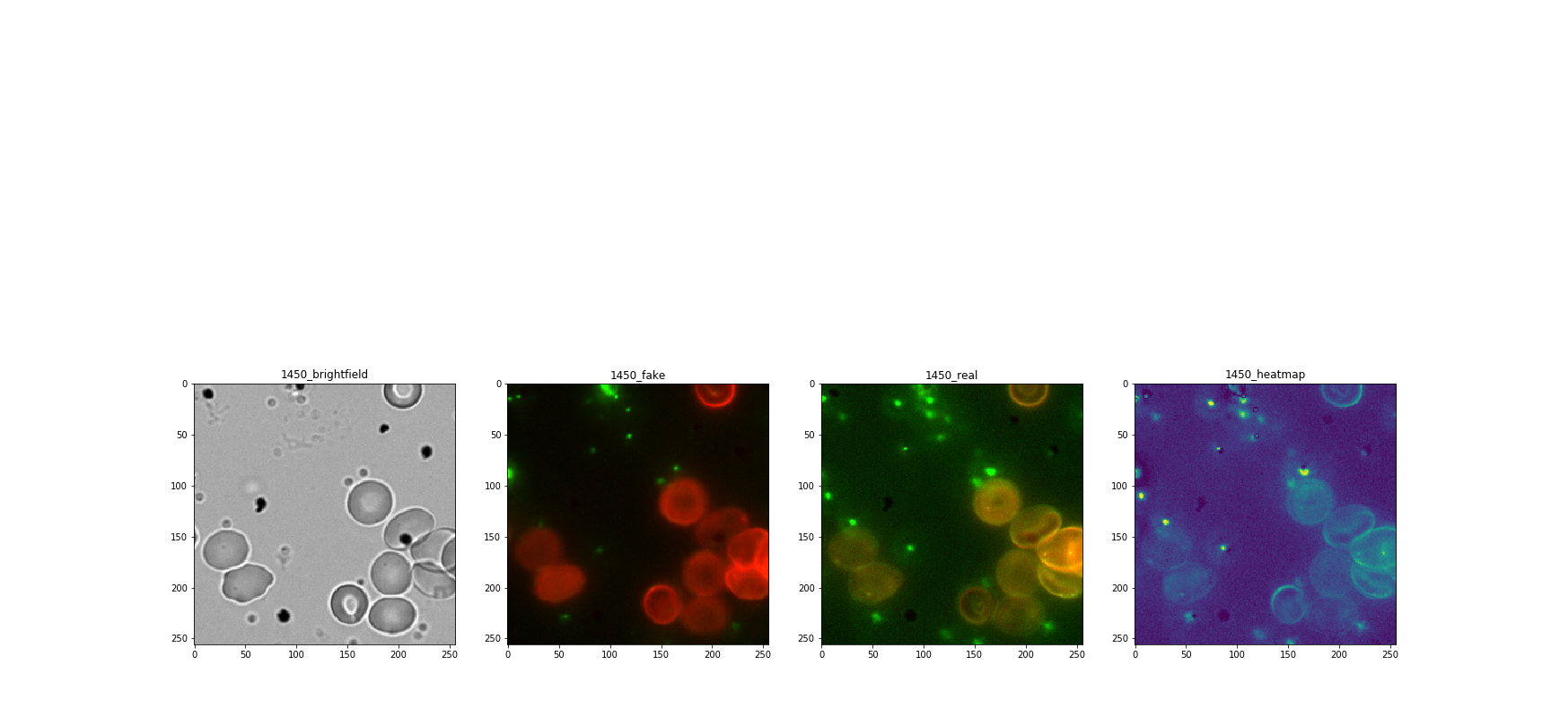
OUTPERFORMS ACTUAL LABELLING
SPECTRAL OVERLAP ELIMINATED WITH CLEARLY DEMARCATED SPECTRA

Slide 23
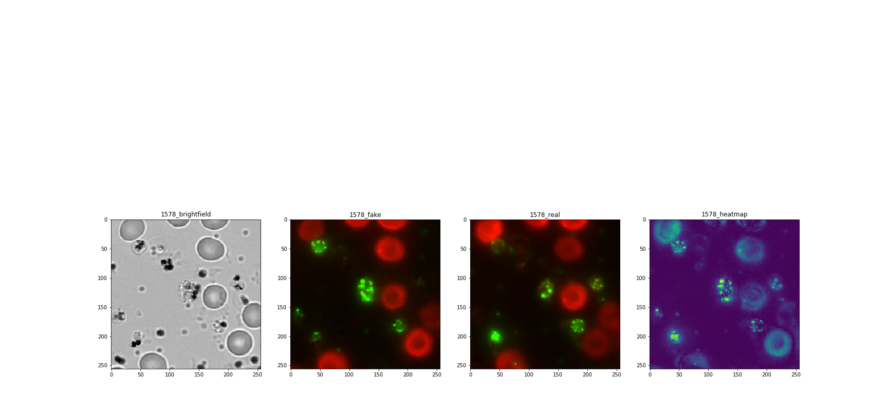
NOTABLY IMPRECISE, HOWEVER
While the general distribution of the parasite is captured, locations are notably imprecise

Slide 24
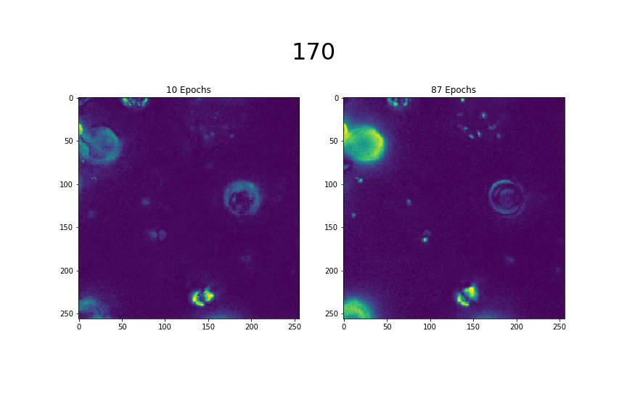
MINIMAL PERFORMANCE ENHANCEMENT OVER INCREASING EPOCHS

Slide 25
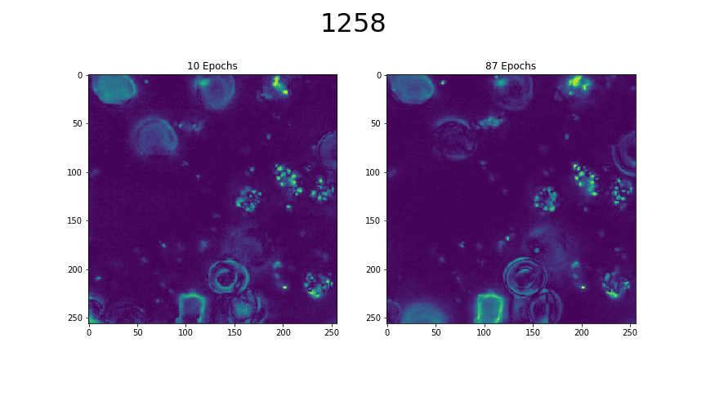

Slide 26
4. TRANSFER LEARNING AND UPSCALING
HOW WELL DOES THIS GENERALISE?

Slide 27
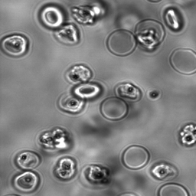
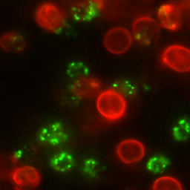
UNSEEN DATA PERFORMANCE
ADEQUATE BACKGROUND FIILTERING and SELECTIVE LABELING

Slide 28

SPATIAL CONTINUITY:
HOW WELL DOES IT STITCH TO FORM A CONTINUOUS, LARGER IMAGE?

Slide 29
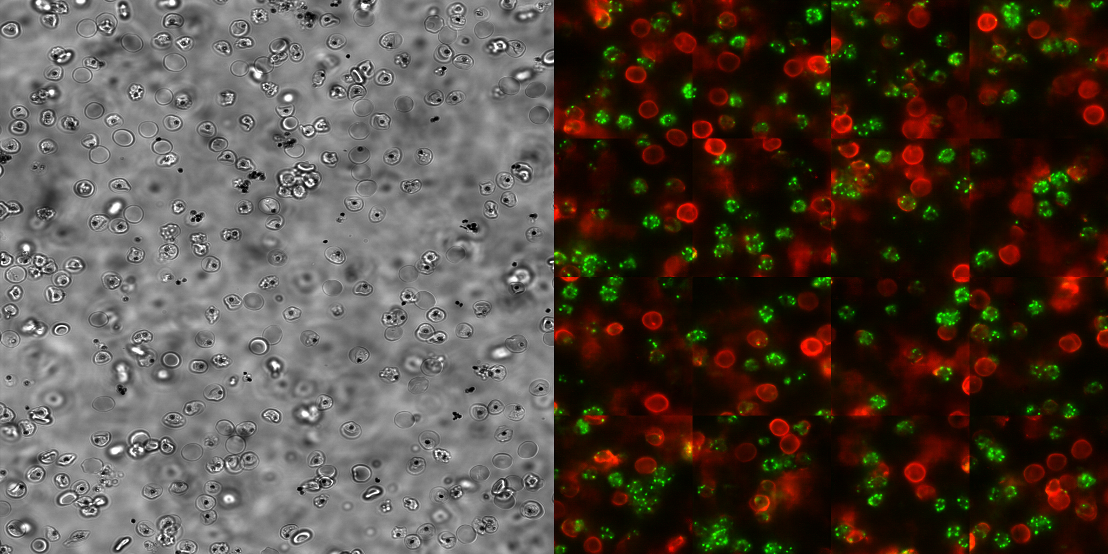

Slide 30

TEMPORAL CONTINUITY
HOW WELL DOES IT PERFORM ON A FRAME BY FRAME BASIS?

Slide 31
https://drive.google.com/file/d/1PcouY9F_A4CfPPlXlsGGcc9LrXuiO9xO/view?usp=sharing

Slide 32
POTENTIAL
CELL SEGMENTATION WITHOUT NEED FOR LABELS
REVEALS HIDDEN MICROSCOPIC INFORMATION SOMEWHAT ACCURATELY
EASILY TRAINS WITHOUT MUCH OVERHEAD NOR TRAINING DATA
GENERALISES TO SIMILAR CASES

Slide 33
FUTURE RESEARCH
BY USING GANs, THE NET IS NOT NECESSARILY “REVEALING HIDDEN INFORMATION” BUT EFFECTIVELY MAKING IT UP, THE VALIDITY OF WHICH IS PROBELMATIC.
OTHER REPOSITORIES, SUCH AS GOOGLE’S ISL PROVIDE A MEANS OF LABELING WITHOUT THE NEED OF GANs, ALTHOUGH THEY FALL SHORT IN ADAPTING TO SPECIFIC USE-CASES.
WHILE GANs SUCH AS PIX2PIXHD LOOK PROMISING IN TERMS OF DELIVERING RESULTS (however superficially), FUTURE DIRECTION SHOULD BE HEADED TOWARDS UNDERSTANDING AND REFINING THE INPUT DATA SO AS TO MAXIMISE THE AMOUNT OF INFORMATION EXPOSED TO THE NEURAL NETWORK.
DEVELOPING METRICS TO EVALUATE THE VALIDITY OF PRODUCED IMAGES REMAINS YET ANOTHER PRIORITY FOR THE SAKE OF PRESERVING ACADMIC INTEGRITY AS WELL AS RIGOUR.

